Slide 1
BanCov Tarlac: A Covid-19 Cases, Recoveries, and Fatalities Tracker Mobile Application for the Province of Tarlac
Marlon R. Malonzo
CMSC 190 – SP Proposal

Slide 2
BACKGROUND OF THE PROBLEM
Covid - 19

Slide 3
Background of the problem: Covid-19
The Coronavirus disease (Covid-19) has been running rampant since January of 2020, not only in our country but also worldwide. It is caused by the SARS-CoV-2 virus [1] and is a very infectious disease to humans.
Currently while writing this paper, there have been 241 million people infected and 5 million deaths caused by this disease worldwide [2]. The impact of the COVID-19 pandemic remains massive as the virus not only affects the health and safety of people but also a country’s economy.
The Philippines is one of the countries heavily affected by the Covid-19 pandemic. As of this date of writing October 19, 2021, the Philippines with 1,149,925 confirmed cases ranks 27 out of 192 countries in terms of Covid-19 Infections and with 19,262 deaths ranks 30 out of 192 countries in terms of deaths caused by Covid-19 [3]. The GDP growth of the country, which measures how fast an economy is growing, has fallen up to -9.6 percent in 2020 because of the pandemic, before having an average of 6 percent GDP growth annually from 2010-2019 [4].

Slide 4
Background of the problem: Province of Tarlac
Central Luzon (Region 3) has the third-highest Covid-19 cases per region in the country with 250,576 in total, only behind NCR and Region IV-A at this date [4], and with Tarlac having 21,621 cases being the 5th most Covid-19 cases in the region. The problem with that is Tarlac as a province is relatively small.
There are only 22 hospitals in the whole province and not all are accepting Covid-19 patients [5]. With limited hospitals that have limited Covid-19 beds, Tarlac cannot afford a high quantity of Covid-19 cases. Vaccination is also relatively slow, with only less than 20 percent of the total population of the province having been fully vaccinated [4].

Slide 5
Objectives of the study

Slide 6
Objectives of the study
The general objective of this study is to create a mobile application that will display daily updates on the Covid-19 situation in the province of Tarlac.
Specific objectives:
to design and create a mobile application that will provide users daily updates on the Covid-19 cases, deaths, and recoveries in the province (new cases, new recoveries, new deaths, total cases, total recoveries, total deaths, active cases);
to create a database that will store the data that will be used by the mobile application;
to create a web application that admins of the application can use to update the Covid-19 related data that will be used in the mobile app;
to test and evaluate the mobile application and web application;

Slide 7
Significance of the study

Slide 8
Significance of the study
Provincial Government of Tarlac. This application will help the provincial government of Tarlac in spreading awareness about the state of the Covid-19 pandemic in the province. The ease of use in tracking and updating the Covid-19 cases, deaths, and recoveries in this application will mean less work and manpower are needed to manage this information.
Tarlaqueños. Having the current Covid-19 updates in the province on your mobile device will greatly benefit the Tarlaqueños in making their informed decisions. Awareness of the disease, knowing where it is currently occurring more in the province, will give the user options to adapt plans accordingly to prevent them from getting the disease.
An advantage for Filipinos. The code of this research will be open-source and modular, so fellow Filipino web and mobile developers can follow the database scheme and modify it for use in their province, to raise more awareness of the disease in their area.

Slide 9
Proposed solution

Slide 10
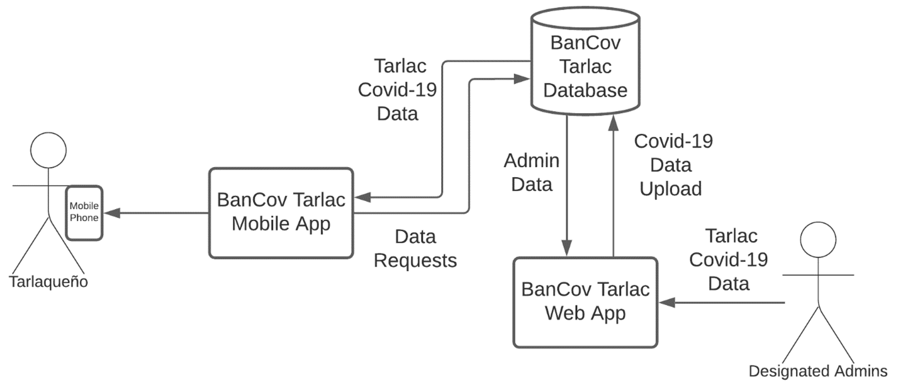
Proposed Solution: Bancov Tarlac
The application will be named BanCov Tarlac that is short for Bantay Covid Tarlac. BanCov Tarlac will be composed of two parts that will need to be developed. First is the mobile application that will be the main application used by the users, and second is the web application that will be operated by the administrators. The database will be shared by these two applications.
Figure1. Bancov Tarlac System Architecture

Slide 11
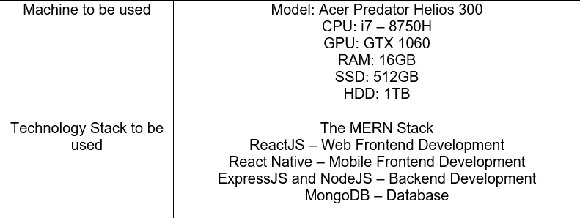
Proposed Solution: The mern stack
Table 1. Machine and Technology Stack to be used for the Development of BanCov Tarlac

Slide 12
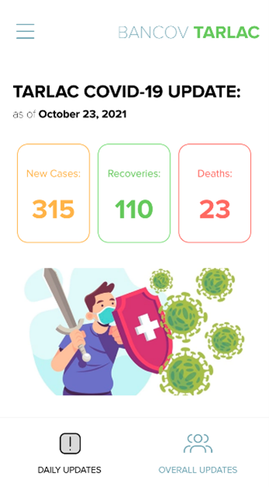
Proposed Solution: Mobile Application
The mobile application BanCov Tarlac will be the main application to be used by the citizens of Tarlac. This application will display covid-19 related information such as Daily Cases, Recoveries, and Deaths of the province of Tarlac to the users.
The mobile application will have the following UI:

Slide 13
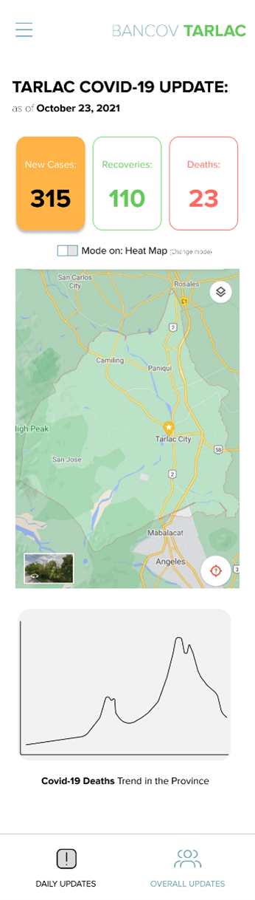
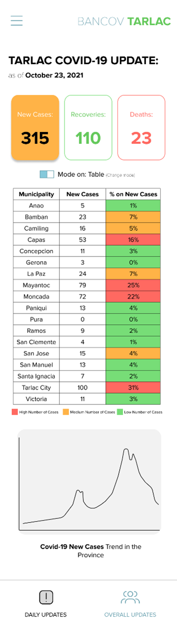
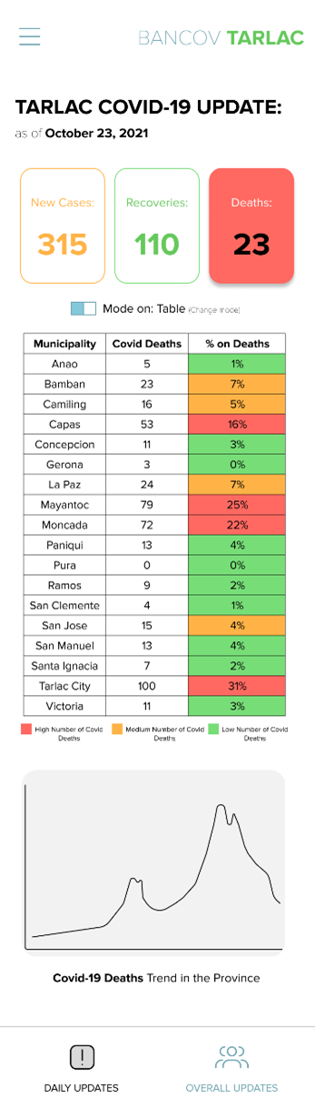
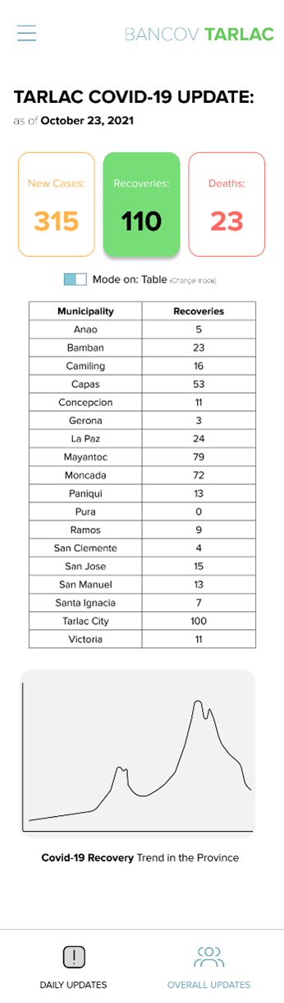
Figure 2. Initial mobile application prototype and design

Slide 14
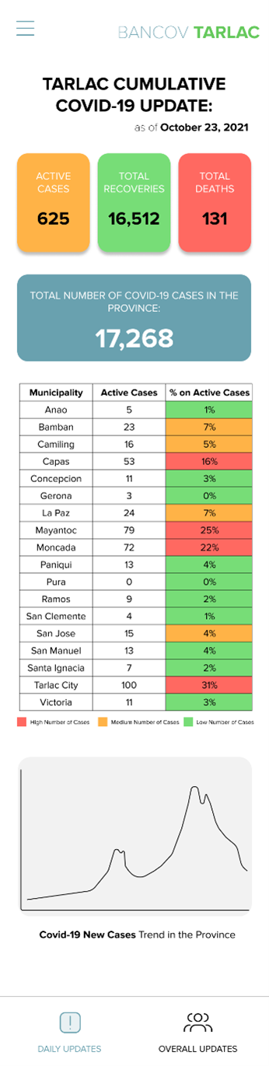
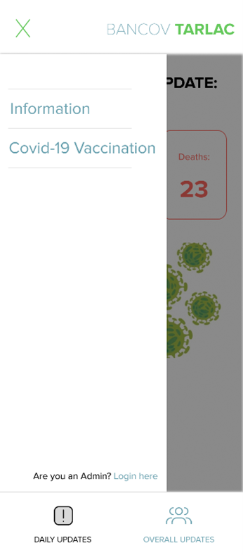
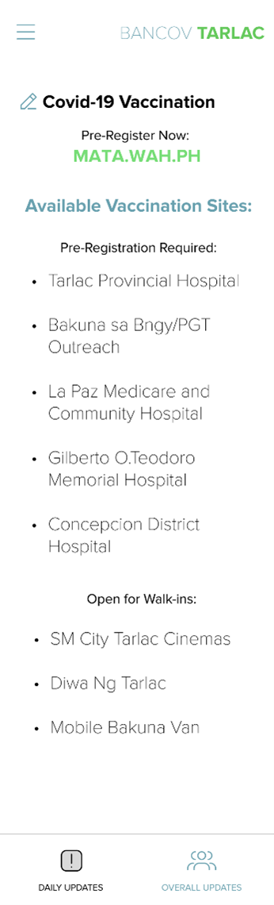
Figure 2. Initial mobile application prototype and design

Slide 15
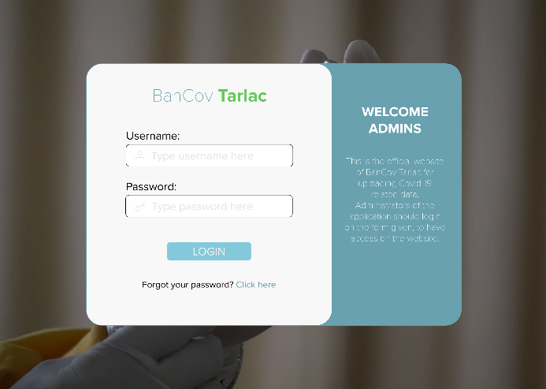
Proposed Solution: Web Application
BanCov Tarlac’s web application will only be accessible by administrators of the application. This web application will be used to upload Covid-19 related data to the database, for the use of the mobile application. It will also be developed using the MERN Stack, with the difference of ReactJS being the UI framework instead of React Native.
The web application will have the following UI:

Slide 16
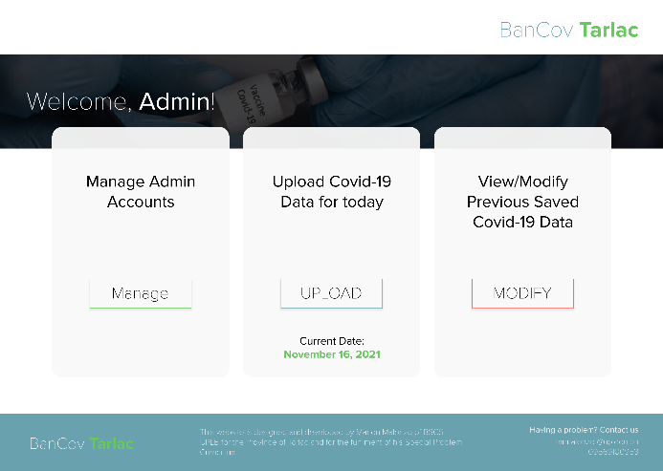
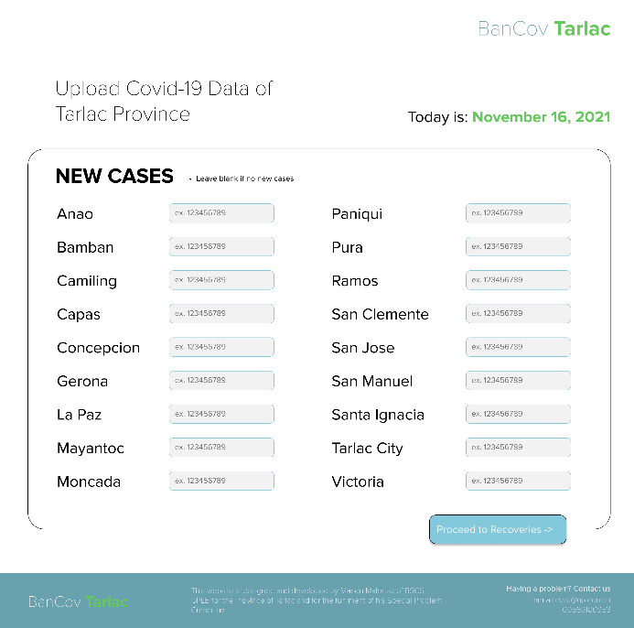
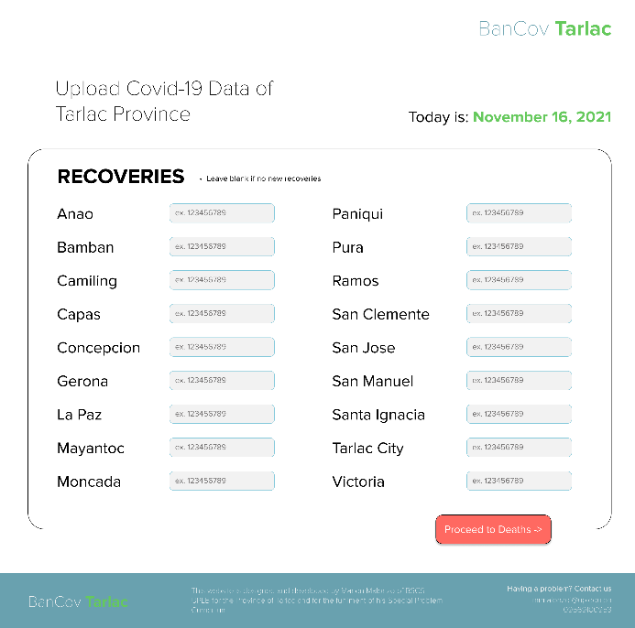
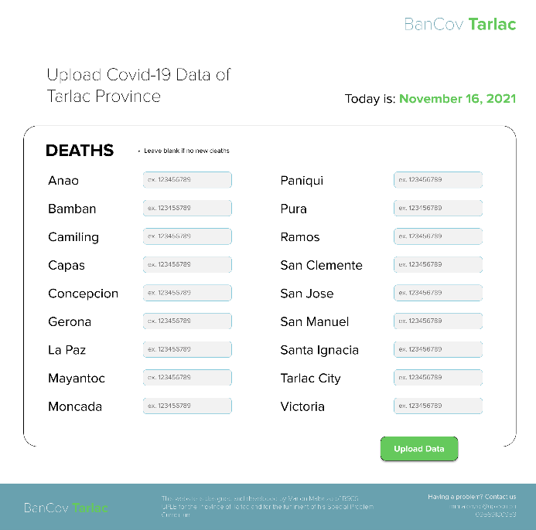
Figure 3. Initial design and prototype of the Web Application

Slide 17
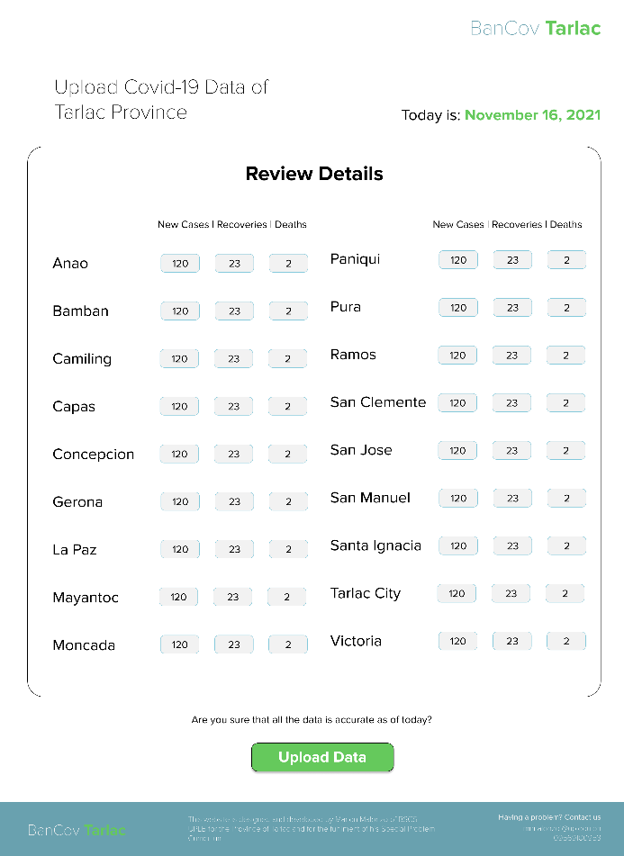
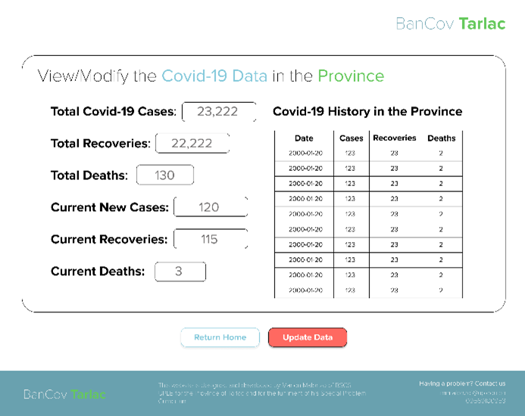
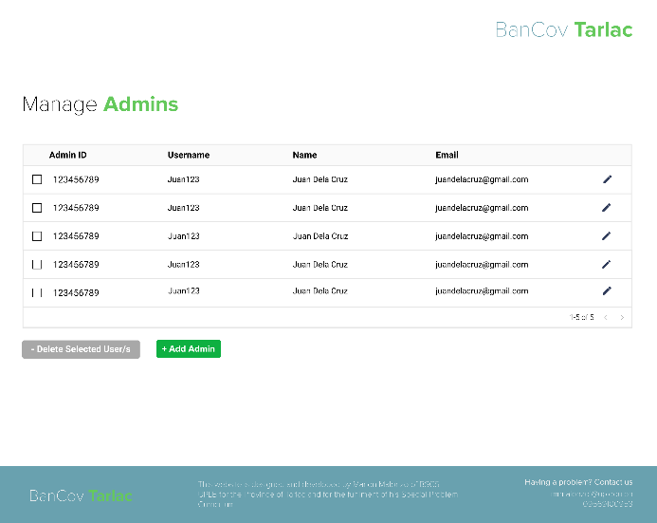
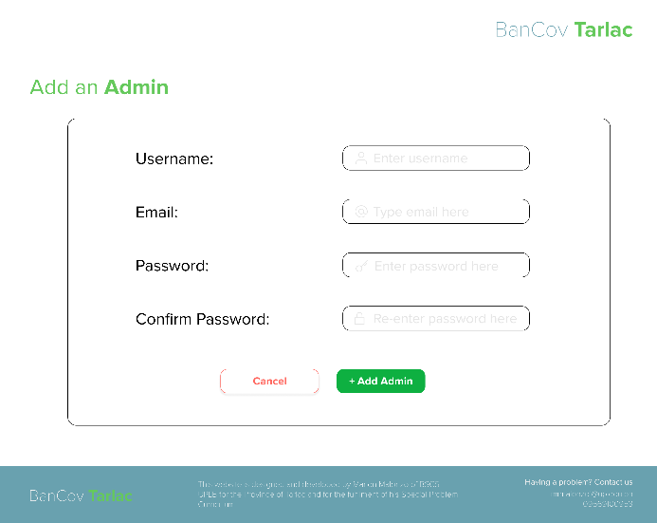
Figure 3. Initial design and prototype of the Web Application

Slide 18
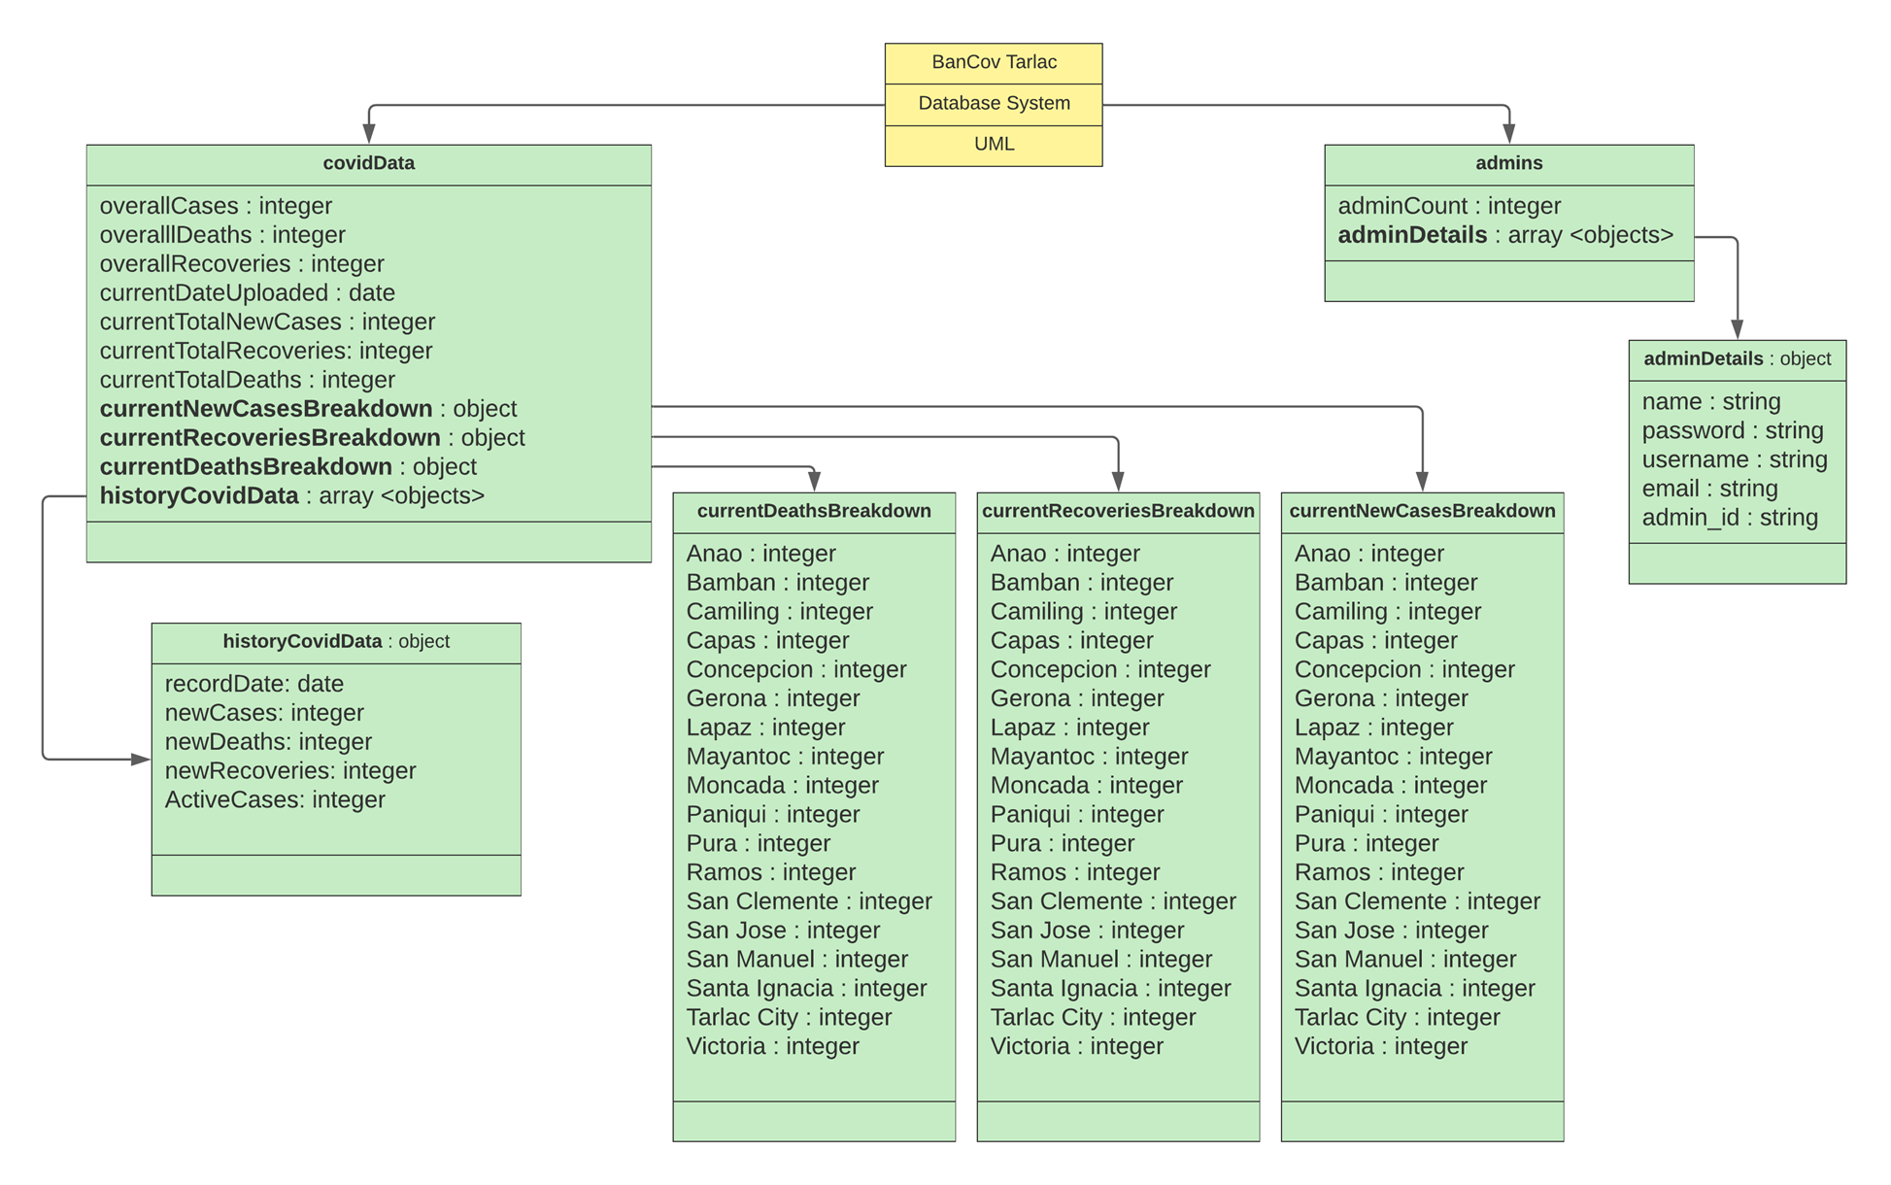
Proposed Solution: Database
MongoDB free tier or Google Cloud free tier will be used as the primary database of BanCov Tarlac.
Figure 4. BanCov Tarlac Database System UML Diagram

Slide 19
Proposed solution: Testing and Evaluation
After the initial development of the applications has been done, it will need to be tested and evaluated. At least five users will test the web application and at least twenty-five users will test the mobile application, totaling to at least 30 respondents. They will then answer the standard system stability test on google forms based on their experience.

Slide 20
References:
[1] WHO, “Coronavirus disease (covid-19),” World Health Organization, 2020. [Online]. Available: https://www.who.int/health-
topics/coronavirus
[2] Worldometer, “Covid-19 coronavirus pandemic,” Accessed Oct. 23, 2021. [Online]. Available: https://www.worldometers.info/coronavirus/
[3] Covid19StatsPH, “New cases: Covid-19 Philippines in numbers,” Accessed Oct. 19, 2021. [Online]. Available: https://covid19stats.ph/stats
[4] D. of Health, “Covid-19 tracker,” Accessed Oct. 26, 2021. [Online]. Available: https://doh.gov.ph/covid19tracker
[5] Philstar, “Covid-19 emergency information tarlac,” Accessed Oct. 19, 2021. [Online]. Available: https://www.philstar.com/covid19emergency/tarlac
[6] B. Davis, “Is mern stack in demand?” MVOrganizing, 2021 ]. [Online]. Available: https://www.mvorganizing.org/is-mern-stack-in-demand/

